Slide 1
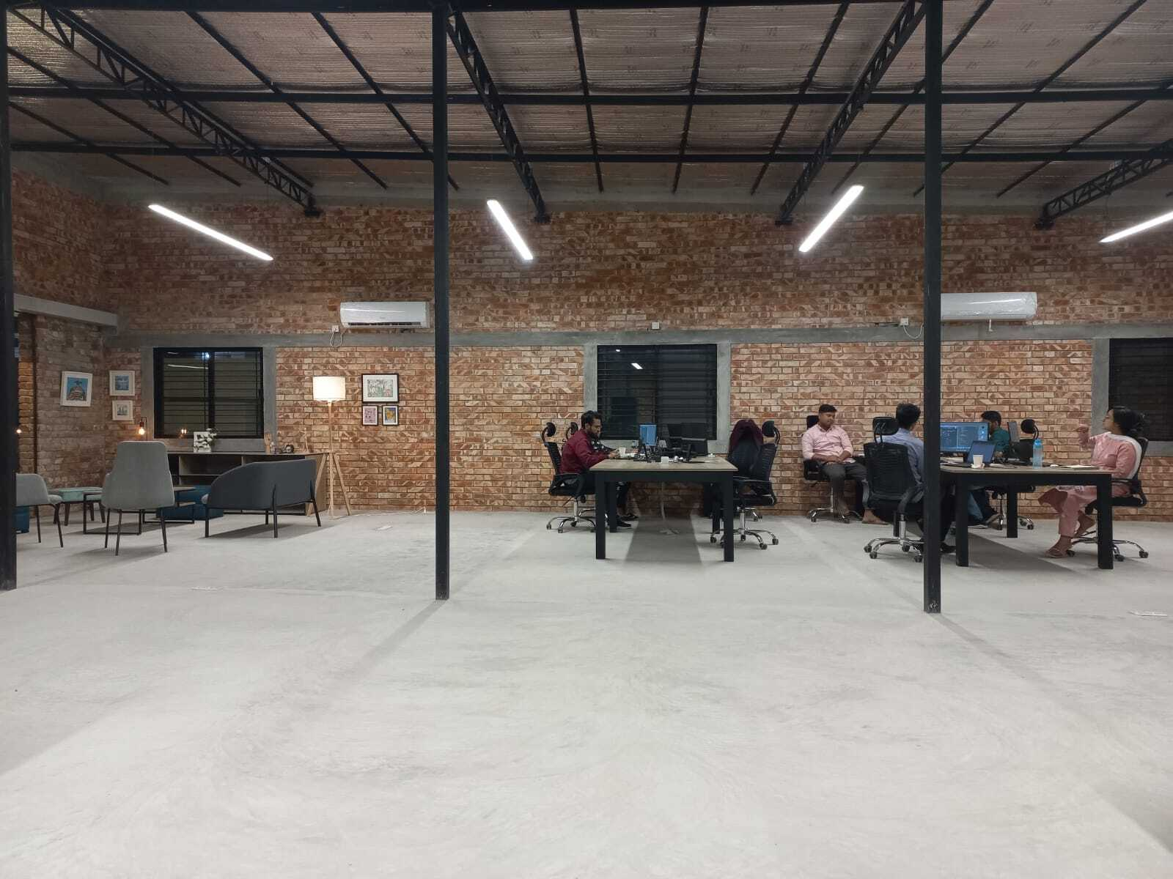
Project Code | PetScan Demo
Building top junior software engineering talents in Bangladesh
Strictly Confidential

Slide 2
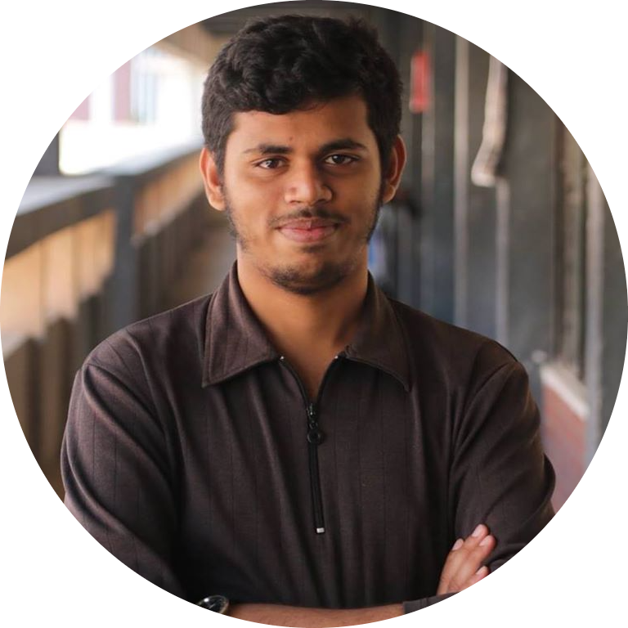
To build something that brings joy and satisfaction to others
Introduction
1
Name
Saimon
2
Age
23
3
Candidate Type
Project Code x SELISE Scholarship Program
4
University & Class
Nuclear Science and Engineering at MIST, 2023
5
Hobbies & Interests
Travelling and Gaming

Slide 3
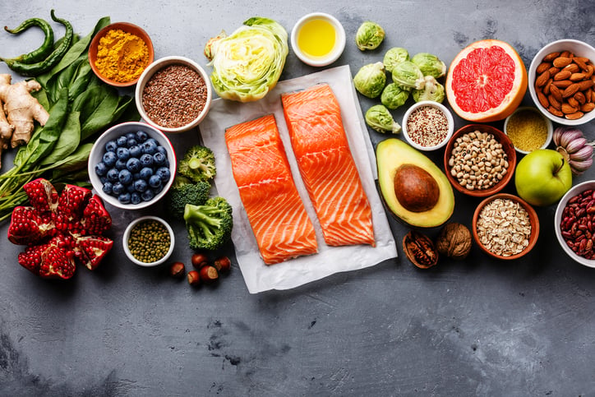

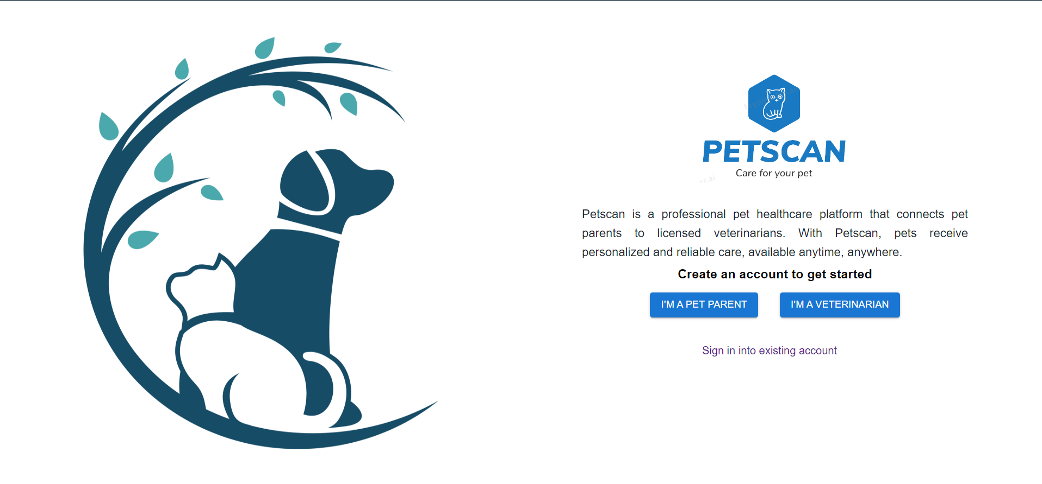
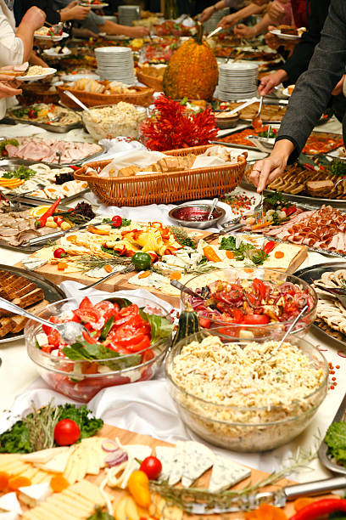
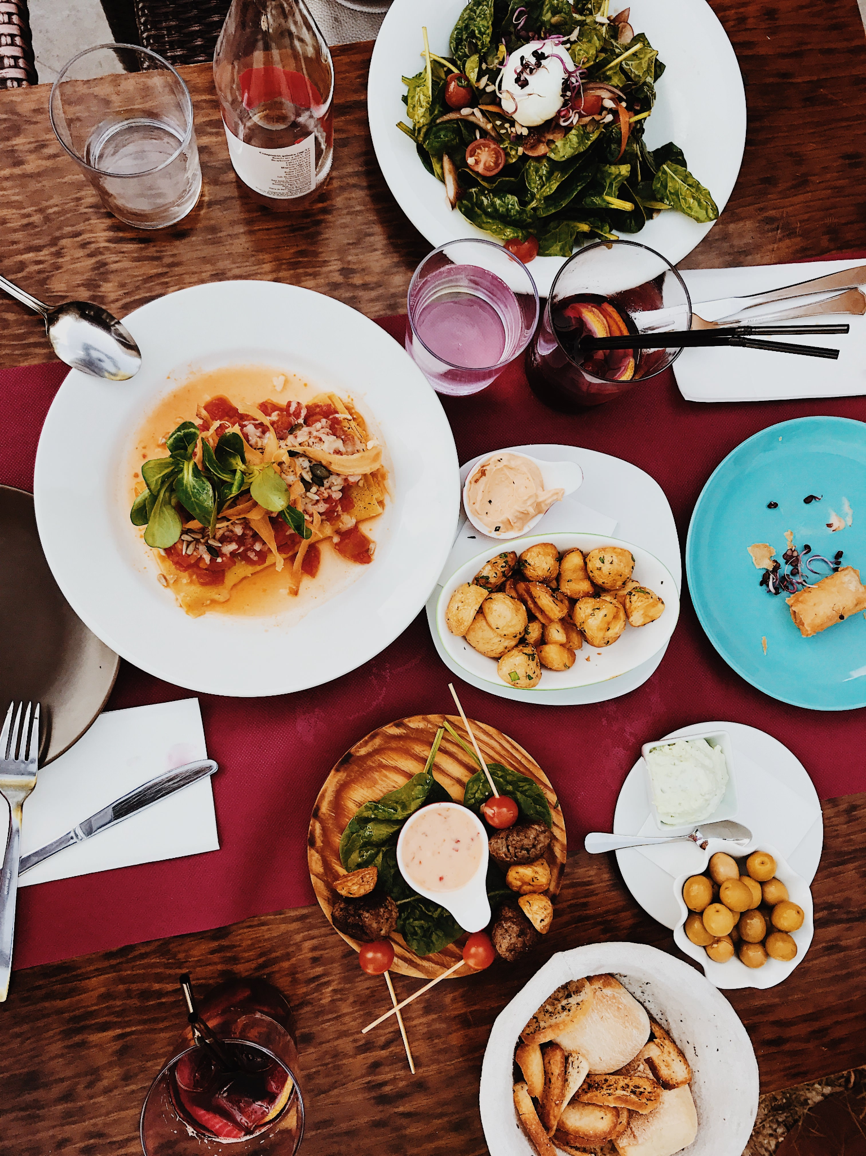
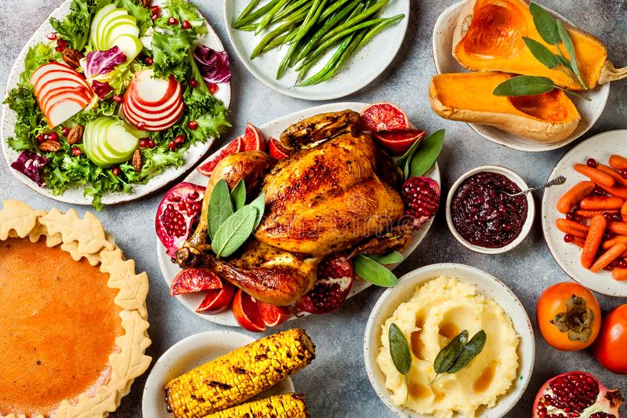
PetScan is a pet health care app offers features for pet owners to book appointments, post on a forum and receive answers from certified Vet. Veterinarians can view appointments, answer pet owner Questions, add prescriptions. The app also allows for video appointments scheduling with a veterinarian through Calendly.
PetScan
Opportunity & Problems
Our Solution
1
Not all areas have easy access to veterinary services
2
time-consuming, especially if there are long wait times or if the clinic is located far from home
3
difficult for pet owners who have busy schedules
4
✓
Information sharing, expert advice
Pet owners can schedule an appointment with the right veterinarians.
✓
Pet Owners can post questions in the community and get answer by experts
✓
A vibrant UI/UX with flexibility

Slide 4
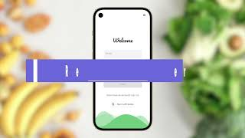
Take control of your own health
Live Demo of MealMate

Slide 5
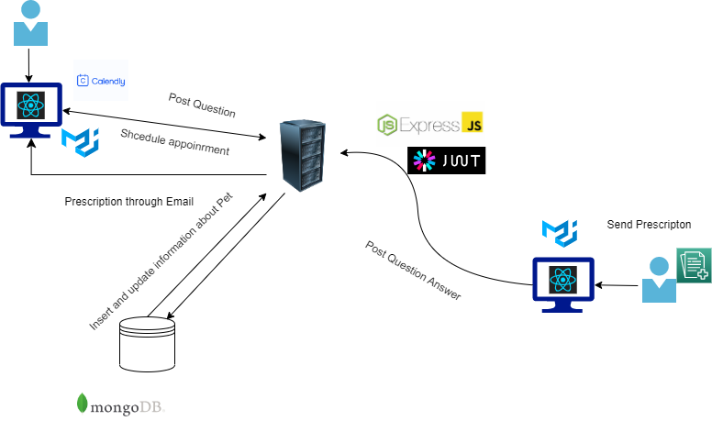
System Architecture of PetScan
System Architecture & Tech Stack Utilized

Slide 6
First time building a MERN Stack application with intense time pressure presented me with challenges, learning opportunities and understanding of common pitfalls
Key Challenges & Takeaways
Main Challenge Faced
Key Takeaway
Integrating Calendly
Using an third party API take a lot of research
Get used to third party API
1
Filtering Vets and send options to users to book an appointment
with best suited vets
Reading official documentation
Making the algorithm efficient enough
Planning total dataflow
2
Maintaining proper data flow throughout my application
Get used to react technology
Adapting my skills accordingly
Planing proper schema of database efficiently
3

Slide 7
Features I would incorporate if I had an additional 1-2 weeks
Future Plan
1
2
3
4
Giving users more flexibility in terms of their
Problem descriptions
Assigning Veterinarians based on location and availability
Making a chat UI
to
allow user
chat with veterinarian
Making the app more responsive
for mobile
user

Slide 8
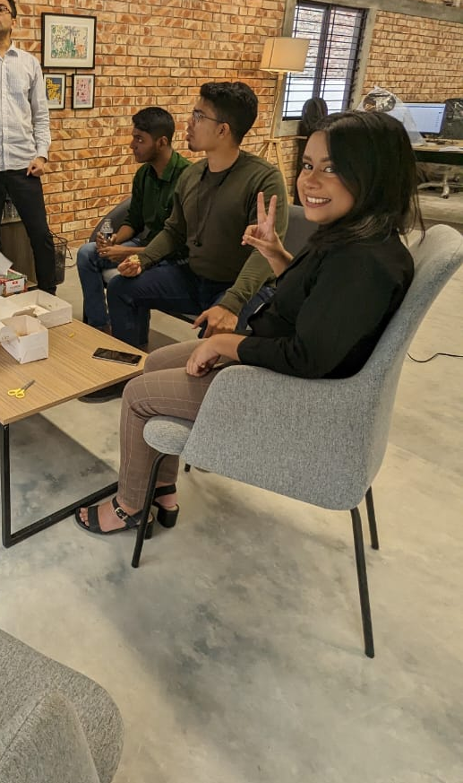
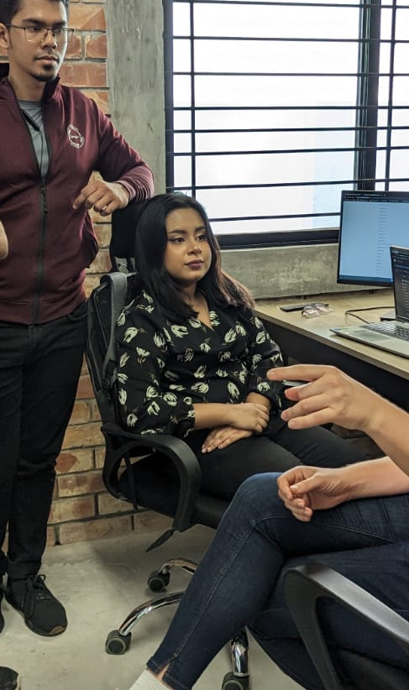
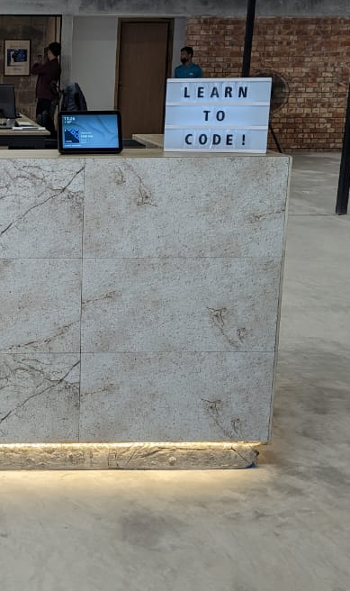
After building my first MERN stack application in just 6 days, I feel…
Closing Remarks
Confident
In building a fullstack app
Accomplished
Finishing what I set out to do
Thankful
For having everyone’s support

Slide 9

Project Code | Bliss Demo
Building top junior software engineering talents in Bangladesh
Strictly Confidential

Slide 10
First time building a MEAN Stack application with intense time pressure presented me with challenges, learning opportunities and understanding of common pitfalls
Key Challenges & Takeaways
Main Challenge Faced
Key Takeaway
Filtering Users and send users to best suited Therapist’s dashboard
Reading official documentation
Making the algorithm efficient enough
Planning total dataflow before starting project
1
Maintaining proper data flow throughout my application
Planing proper schema of database efficiently
Making the code DRY
2
Integrating Calendly
Get used to third party API
Adapting my skills accordingly
3

Slide 11
Features I would incorporate if I had an additional 1-2 weeks
Future Plan
1
2
3
4
Assigning therapist based on location and availability
Higher admin control for therapist sign up i.e. KYC
Making the chat UI more mobile friendly
Making chat queries more interactive based on user’s input

Slide 12



After building my first MEAN stack application in just 6 days, I feel…
Closing Remarks
Confident
About building full stack project
Connected
With my project
Blessed
To have everyone in project code who have supported me throughout the project

